Slide 1
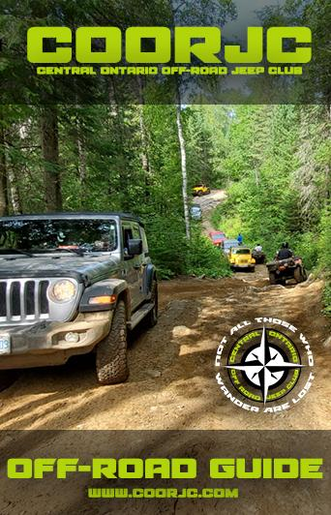
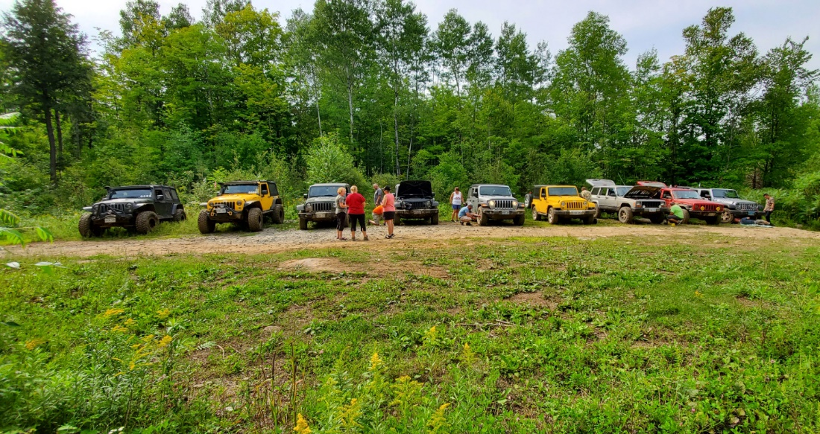
Before you start
These are some of the most basic premises you need to know for safe and sane 4x4 driving. Of course, we’re talking about the basics here, not how to run the Rubicon at night, backwards, and with no lights. That’s a bit more complicated, but the principles we’ll discuss still apply.
Along with driving off road comes responsibility. Responsibility includes more than telling someone where we’re going and when we’ll be expected back. It also means responsibility for the land on which we drive. As members of COORJC we care about the great outdoors and our diminishing rights to use it. On public property, think twice before blasting across a swampy meadow, creating a new trail, or mowing down some trees – this just gives governments and interest groups an excuse to close the lands we all want to enjoy.
Whether you are new to the sport, or an old trail hand, remember that driver experience wins out over vehicular modifications in most situations. An experienced driver will recognize what terrain is beyond the limits of his vehicle and know when to call it quits. Likewise, a good driver can be capable of taking a stock vehicle through obstacles that a newbie driver would find difficult. With a stock or lightly modified rig, driving techniques definitely come into play. Knowing how to use throttle, gravity, and inertia is also important and often makes the difference between getting through a bad section or getting stuck and needing a tow. The key is not to overdo it, but to use these variables to your advantage.
Different types of terrain often require somewhat different techniques, included here you will find sections that deal with what you may come up against and where. There are also basic manners and a checklist of things you should have to cover the basics that apply to most off-road adventures, and what you need to safely overcome even the roughest of obstacles. So after reading this guide please feel free to put this in your glove box for future reference. We hope you enjoy this guide and your many years to come of responsible off road adventures!
Put on your seatbelt, and instruct passengers to put them on as well!
A good belt will help restrain you when driving difficult terrain, and can save your life in case of a rollover or other accident. Seatbelts are especially good to wear when driving with your doors off.

Slide 2
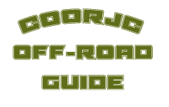
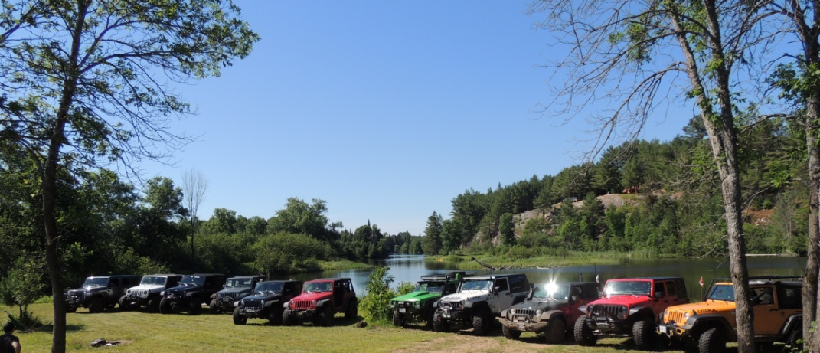
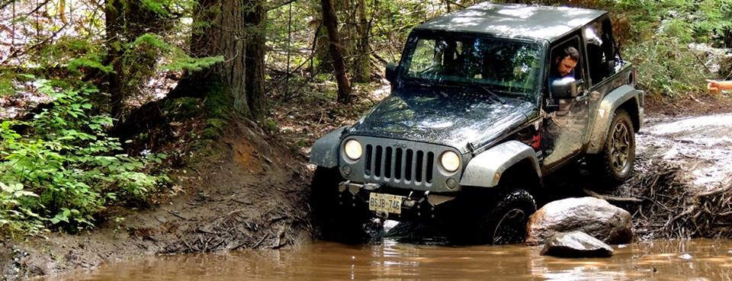
The BASICS – WHAT YOU NEED TO KNOW!
Watch the driver in front of you and see how he makes it through.
You can learn a lot on what to do and what not to do. Get out and walk the trail or examine the obstacle before you drive through. This allows you to get a mental picture of where you will place your tires before you go. Just as a golfer examines the green before that game-winning putt, you need to know what’s ahead of you so you don’t get into trouble. Walk ahead and look back; the view is different from the other direction, and other features of the terrain become apparent.
Turn your stereo OFF, so you can hear what your vehicle is telling you.
The sounds of slipping tires, scraping metal, and engine rpm can all help you be a better driver, but not if you can’t hear them.
Stay off the clutch unless you need it is important in many situations. While automatic-equipped 4x4s can have an easier time crawling over things, a manual transmission rig is capable of outdoing an auto as long as the clutch isn’t always used. Try driving with your feet on the floor for practice, and see what your rig can do. Once you push in the clutch you’ve unhooked the drive train, and only your brakes will be holding you on a hill.
Lower your tire pressure according to the terrain and speed.
Tire pressure lower than the manufacturer’s recommendations can provide greater tire traction, flexibility, flotation, and a smoother ride. When the tires pressure is lowered the tread spreads out giving you a bigger footprint on the ground. Never air down farther than what you are comfortable with/what is recommended as side wall damage can occur. Remember to air back up to specs when you hit the pavement.
Listen to and watch your spotter. If you’re unsure of what you’re doing while driving an obstacle, ask someone to spot you over the tough areas. An experienced spotter can be your best ally and make you look like a pro. Remember, though, that you as a driver are the one in command, and it’s your decision to trust the spotter or not.
This guide is designed to instill confidence
in your driving abilities, let you experience
your vehicle in varied condition’s, learn its
abilities and disabilities. Family fun and
adventure is more than possible with your
4wd. We are here to teach you how to do it
correctly and with confidence.
There’s no reason to damage your
vehicle. As with anything you do,
practice makes perfect.
To begin, one must always start at the beginning.
Through out this guide is a series of “How To” sections: The Basics, Trail Ratings and Off-road Checklists. Be sure to read through them and learn from our experience.
1) Read your owners manual thoroughly before going off-road, or on road for that matter. Learn your vehicle.
2) Never go out alone as a short trip could be costly. Venturing off the highway alone is never suggested. One can’t foresee everything that could go wrong.
Being prepared yourself, having your vehicle prepared and maintained to a reasonable degree will help counter some problems, but not all. A thought: You're ten miles off the main paved road, your 4WD quits, you have an accident, or someone is injured; Now what?

Slide 3
The BASICS – WHAT YOU NEED TO KNOW! … Continued
The BASICS – WHAT YOU NEED TO KNOW! … Continued
3) Always make sure your vehicle is prepared before leaving. Read “Preparing
& Maintaining”.
4) Adopt a relaxed and upright driving position with a loose grip on the steering wheel, taking note to keep your thumbs out of the center section of the wheel, thus avoiding broken thumbs from steering wheel kick-back. This is a common problem on vehicles not equipped with power assisted steering.
5) Contact between your right foot and the gearbox tunnel will help increase
throttle control. DO NOT use the clutch pedal as a “dead -pedal”. Once the clutch is engaged (out), keep your foot clear.
6) Know your minimum ground clearance.
i) On vehicles equipped with “live” axles (fixed), the minimum ground clearance is the lowest point of the axle housing, normally the differential. This minimum clearance always remains the same as the axle goes up/down with the wheels. To obtain your minimum clearance, measure from the differential housing (its lowest point) to the ground, there it is, your minimum ground clearance. The minimum won’t change, though maximum can when a wheel climbs up.
ii) On vehicles fitted with independent suspension however, the front wheels are attached to the A-arms which go up/down independently from each other, at the same time the center portion of the chassis/suspension goes up/down as well, though the exact opposite of the wheels. Type of terrain, as well as braking can effect your ground clearance dramatically; when the front wheels are bottomed on their suspension points (up in the fenders as far as they can go), your chassis and front suspension pivot points are now very vulnerable to damage as they come closer to the obstacle. It is a proven fact, that for heavy duty off-road work vehicles fitted with “live” axles are preferred.
7) Suspension & Wheel Travel.
Since the time man first developed wheeled vehicles his thought must have been on smoothing the ride. Leaf springs have been around since what must be the beginning of time. Horse drawn wagons, buggies and the famed stage coaches had leaf springs. The leaf spring has two advantages over any other form of suspension, in that a) it’s cheap to produce, and b) they will carry heavy loads. A number of today’s 4wds are still built with leaf springs, while others have gone the Coil spring route. Coil springs do allow heavy carrying capacities to an extent while offering a smoother ride and better wheel travel/articulation
(movement up/down & angle of axle). Other manufactures have sought to create car like rides on their 4WD vehicles by fitting independent front suspension, either torsion bar or coil sprung, though neither of which is in its element when off-road. The best set up? Coil sprung/Live axles; this set up offers smooth ride with extreme rates of wheel travel (wheel movement up/down) and is still cost effective to build. Independent front suspension, as described in #6A, is expensive, car like, and offers little to the off-roader, as it can be damaged easier than a live axle, has more pieces to maintain/damage, and can not offer
the wheel travel and stability when off-road.
8) Know your “Approach angle”, “Break-over” and “Departure angle”. Knowing these figures (i.e.: Clearance), you’ll be able to negotiate obstacles much easier without damage to your vehicle. Interested in learning what these figures are on your vehicle? Try a long broom stick. Placing it under the edge of the tire, then lifting up until it makes contact with the body, you now have some idea of your angles. When off-road, drive up to your obstacle slowly, then stop get out and look to check clearances upon approach. When clearing the obstacle, be careful to “walk” the rear wheels off, remembering always that most 4WD vehicles have some sort of overhang beyond the rear axle (when “walking” your 4x4, the use of brakes, a spotter and your own sight will enable you to creep the rear wheels off the obstacle). Damage will result if care is not taken. As far as break-over is concerned, also know as “high-centered”, this too will take a keen eye, the assistance of a spotter, and practice.
9) Know your vehicles height and width. Think about parking garages and parking spaces, will your 4WD clear the obstructions within the structure? Now apply the same to overhanging trees, narrow washes and rocks. Easy really.
10) Check the area(s) in which you plan to travel off-road. Ask locals about conditions. Purchase and review local maps. And... When in doubt, get out and take a brief walk to review the terrain ahead. This walk could save hours of digging and/or winching, or the anguish of having your new 4WD damaged.
11) Be aware of changing weather conditions, the last thing you want is to get caught off guard. Beware of fast running water... if you can’t swim it, don’t drive into it. Many vehicles have been lost in rough weather and water. Beware!
12) Know your Four-wheel-drive system. Unlike days gone by, the systems of today vary in their modes of operations and capabilities. Review your owner’s manual or talk with an expert concerning your vehicle make. Don’t assume anything.
13) Engage Low-Range before you need it. Choose the correct gear for the situation, see #12. Note: On vehicles fitted with a manual center “Diff-Lock”, this should be disengaged once traction has been regained. However, Low-Range should be kept engaged until clear of the hazardous area(s). FYI: This center differential-lock is just that, a lock, locking the front & rear drive outputs of the transfer case together. When unlocked (disengaged) it will prevent “axle windup” with in the drive train. Vehicles fitted with a standard High-Low/2wd-4wd system
have no center-differential, and when engaged in 4WD for long periods they will induce axle windup. You may notice that in tight turns while in 4WD that the front wheels will seem to hop and buck, this is the windup trying to escape from the system. Don’t be alarmed.
14) Make your choice of gear selection before entering a difficult section. Remember that you should ALWAYS use 1st gear (First, Low-Range) on down-hills for maximum engine braking effect, and keep the use of brakes to an absolute minimum, the use of which could cause sliding and loss of control.

Slide 4
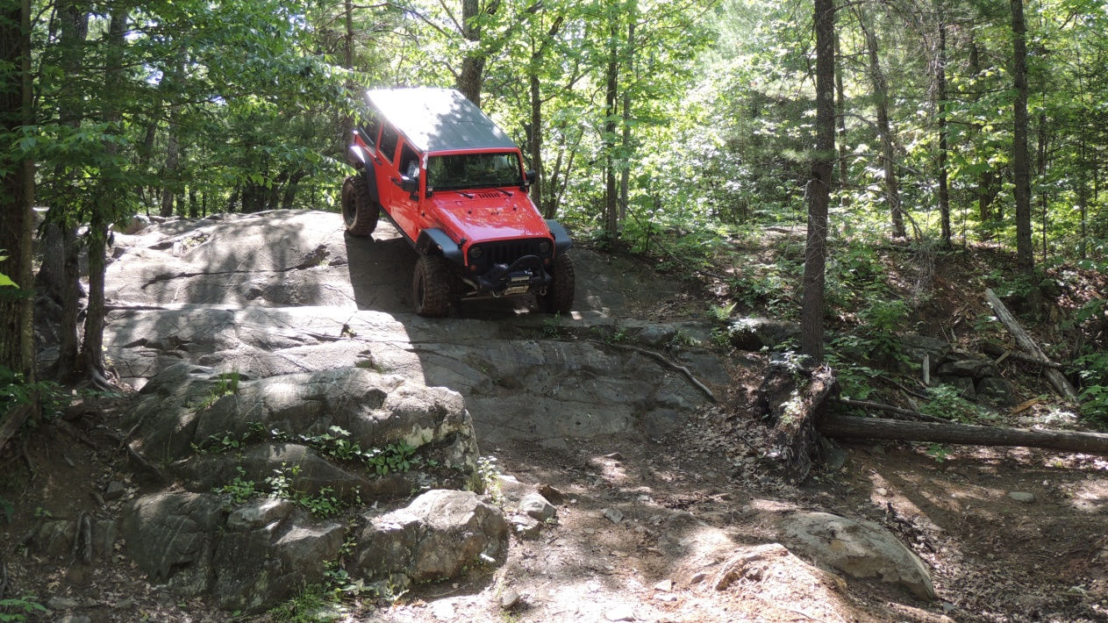
The BASICS – WHAT YOU NEED TO KNOW! … Continued
The BASICS – WHAT YOU NEED TO KNOW! … Continued
To correct a sliding vehicle, turn into the slide and apply some throttle, you will now have to straighten the steering wheel and let off the throttle. Gear selection for up-hill use depends on the make of vehicle, though 2nd or 3rd would be a good place to start. Choosing too high a gear can lug or stall an engine, keep you eye on the tach. Using steady revs of 1800-2200 rpm is a good starting point.
15) If conditions are soft (marshy ground, sand, etc.) it may be advisable to lower tire pressures. This helps improve traction, and will reduce sinking. Tires will
have to be re-inflated for road use.
16) When ground conditions appear difficult, such as rocks, ruts, etc., it is
advisable to select a path by foot prior to driving through, thus reducing the
chance of getting stuck or damaging your vehicle. The use of a spotter is also
recommended.
17) Exercise care when applying the throttle. Excess throttle will cause wheel
spin (digging) and could stop forward movement. Don’t dig with your wheels,
otherwise you’ll be digging with a shovel!
18) Momentum of a fast moving vehicle will always overcome the drag and
reduce the traction needed from the wheels. When it is clear that NO obstacle is
in the way to cause damage, a fast approach to a steep hill, soft sand, mud, etc.,
can very often be effective.
19) When crossing ditches, ruts, logs, etc., always try to keep as many wheels
as possible on the same type of surface. Avoid getting the wheels airborne. Also
ditch & log crossings should be done at 45-degree angles, not head on, thus
keeping traction loss to one wheel only.
20) Always be aware of obstacles under your vehicle, keeping in mind you
only have so much ground clearance. Avoid existing deep ruts, sudden changes
in slopes, plus remember your approach and departure angles.
21) Maximum advisable wading depth is approx 20-inches. If equipped, fit
the bell housing wading plug prior to setting out. Make sure your engine air intake
does not suck water; otherwise great engine damage will occur. Though some
vehicles are known for driving through deep water, we don’t suggest it (you need
specialized vehicles & equipment). If you have to cross that stream, survey it first.
If the water is glass smooth and you can’t see the bottom, a muddy bottom is
usually the norm. If choppy and rough, rocks are then the cause. When surveying
you’ll have to check depth, current speed, condition of the stream bottom (does it
offer traction or not?). Don’t try driving against the current, and if you have to
cross, take it a right angles or angle your way down stream to the opposite bank,
letting the current help you along. You are in... Don’t splash, this will normally cause
an engine to be soaked (causing it to quit, or suck water down the air cleaner).
Begin slowly and create a “bow-wake”, taking care to keep a steady speed.
22) After driving through deep water (or mud), make sure your brakes are dried
out immediately, thus being fully operational when needed. This can be done by
driving a short distance with the brake pedal applied lightly. You should also
check your air filter for water.
23) When dealing with mud, refer to #10, 13, 14, 15, 16, 17 & 18 for starters.
Now think about what gear you’ll use, we normally try second gear low-range
(possibly 3rd with a V8 & automatic), keep a steady speed, not too fast, and try
not to spin the wheels, as if they are, you are not going forward. If you loose
forward movement, lift off the throttle slightly, enough to stop the spinning and
see if you regain traction, normally you will. Throttle control and traction is the
key to driving in the mud.

Slide 5
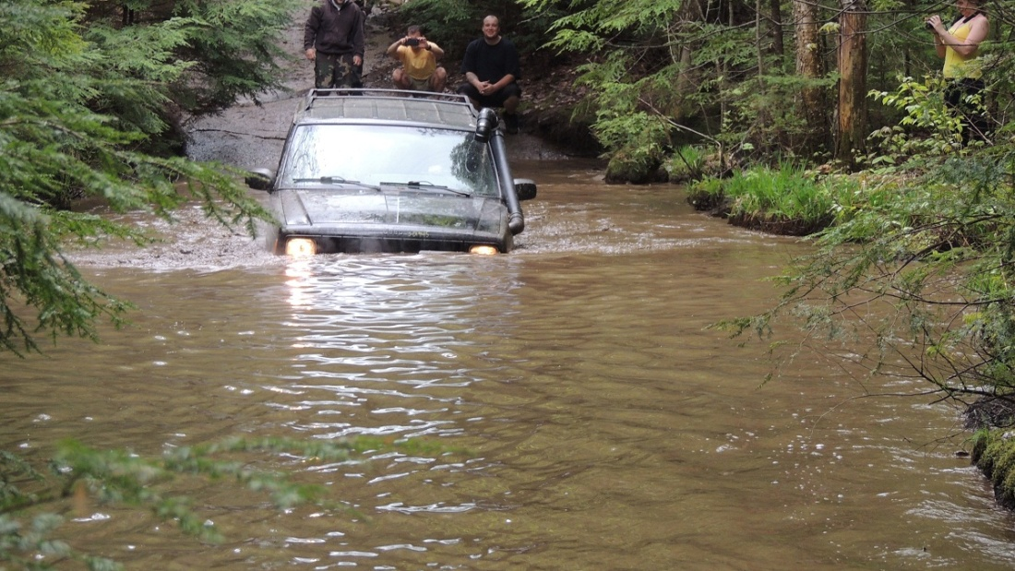
The BASICS – WHAT YOU NEED TO KNOW! … Continued
The BASICS – WHAT YOU NEED TO KNOW! … Continued
24) Should you get stuck, careful thought and experience will usually provide a solution. However, the trick is not to get stuck in the first place. The idea of having a winch is great, but just in case you don’t have one, looks at your situation, then clear any/all obstacles from in front of all four tires. Adjust air pressure as necessary, and then begin a rocking motion (forward-reverse, etc.). In most cases it will do the trick. If not, it may be necessary to jack up the car and place rocks, matting, etc., under the tires for added traction. It may also be
necessary to remove all payloads from the load space area.
25) Tires... There are so many different types of tires available now days that choosing the correct one for you and your vehicle may get a bit confusing. Consider where you live (Snow Belt ). Think of your primary use first, and then consider how much off-reading you really do. If you’re commuting everyday, you really don’t need Mud T/A’s. Don’t over-tire your vehicle either. Always remember that all wheels, including the spare must be of the same type, size
and make. Excessive tire pressure will give a poor ride and poor handling. Check your owner’s manual first, then tire manufacturer specifications. Do not blow the tires up to their maximum for general road & off-road work, it’s too high.
26) Rocks, these can be tricky, and it’s almost an art, When off-road however, you’ll
always encounter rocks of some sort or another. Careful driving and spotting can help you avoid vehicle and wheel/tire damage (be careful with the sidewalls on your tires, rocks can tear them open). Survey the area chosen first. Walk it. Use your spotter as necessary. Find that path through. Drive slowly and with caution, remembering your ground clearance, approach/departure angles, plus your break-over clearance. If rocks are too large to put under your car, you’ll have to go around, or... over them. Be careful.
27) Hill climbing, some think, is a sport in itself. When you see off-roaders rushing up a particular hill for the sole reason of getting to the top, you can be sure trouble isn’t too far behind. In most cases this is a useless sport, damaging the trails, and usually the vehicle (everything from broken axle shafts from excessive wheel spin, to roll over’s). If you have to go up, refer to #14 & 18 for starters. Should your vehicle stall part way up, don’t panic! Quickly hold the brakes, engage reverse (re-start engine if needed) and release all pedals, letting the
vehicle back down in gear via engine braking, stay off the brakes! With the engine now above you, and the weight shifted onto the rear axle, your vehicle is quite unstable and can go into roll-over-mode very easy. If the front end begins to slide to one side, quick use of the throttle will straighten the vehicle out, as soon as it’s once again straight with the trail, release the throttle, DO NOT touch the brakes, as the front end will try to pass the rear when the weight shifts further. We’ve seen what happens to a number of these types of off-road
wrecks, sometimes with nasty and deadly results. When coming down front first, engage low-range/first gear and then nose it over the edge. Let the engine and gearbox do all the work (engine braking). Don’t panic, try and stay off the brake pedal. If it starts sliding, touch the throttle enough to overcome (out run) the slide, and then release the pedal once again
letting the engine do its thing. Easy really.
28) Side slopes are another hazard. Some vehicles can operate on a 45-degree side slope, but only with traction. Basically, try to avoid such dangerous situations when possible.
29) Don’t overload your vehicle. Keep in mind that loads should be distributed evenly
within the vehicle if at all possible. Loads behind the rear axle will sag the rear of the
vehicles, thus limiting departure angle/clearance. When a roof rack is fitted be extremely aware of weights and how they are distributed. Excessive loads will change the center-of-gravity, thus making the vehicle less stable. Also, beware of the additional height of the vehicle with the rack fitted.
30) Once clear of your off-road area it is most important that you check over your vehicle completely before commencing with your highway travel. It is important that the vehicle is checked over completely for leaks or brush hanging from the frame, or anything else that could prove hazardous to you and your vehicle or other drivers before commencing freeway speeds and travel. Be sure to check & inflate the tires.
31) A quick and brief reminder...
• Remember to check out difficult or unfamiliar terrain.
• Remember to drive smoothly with throttle, brake and steering control.
• Remember to use common sense, it may be all you have.
• Remember to always wear your seatbelt.
• Remember to drive with in your abilities, not over your head.
• Remember to never go out alone.
• Remember to use 1st gear/low-range on down hills... engine braking.
• Remember to always check your car afterwards, re-inflate tires, etc.
• Remember to TREAD LIGHTLY!

Slide 6
OF4WD Trail Rating System
Off Road Etiquette
2 Easy 2WD/4WD
Features trails with obstacles that are easy to navigate. In optimum weather conditions, these trails may not require the continual use of four-wheel drive (4WD). Expect ruts, wash outs and water crossings to 6” small rocks and holes, stock vehicle
2+ Easy 4WD
Moderately demanding trails on which 4WD will be required. You may encounter a wide variety of challenges (Potholes, minor washouts, water crossing depth to 10”, medium size rocks, and mud holes) on these trails. Higher ground clearance and Off-Road tires are recommended. Simple recovery gear recommended for stock vehicles (recovery strap)
3 Standard 4WD trail
Demanding trails on which 4WD is required. You will encounter a variety of more difficult challenges (loose rocks, large potholes, water crossing depth to 15”, steep inclines 15 deg and large rocks to 10”, 8” mud filled ruts) on these trails. Possible with stock 4WD vehicle, however, recommend traction device (limited slip or locker) in rear differential, aggressive tread and low air pressure. Higher than stock ground clearance is advisable. Low range gears used often. Moderate experience and driving skill advised. Possible paint and/or rocker-panel damage. Recovery gear recommended (Straps/ Hi-lift)
3+ Challenging 4WD trail
You will encounter a variety of more difficult challenges (loose rocks, large potholes, water crossings to 20”, steep inclines 20 deg and large rocks to 12”, 12” mud filled ruts) on these trails. Not recommended with stock 4WD vehicle. Traction device (limited slip or locker) in rear differential, aggressive tread and low air pressure highly recommended. Higher than stock ground clearance is advisable. Moderate experience and driving skill advised. Likely paint and possible rocker-panel damage. Hi-lifts, straps and winches recommended
4 Difficult trail
These trails traverse very rugged terrain (water crossings 24”+, large rocks to 15”+, deep mud, steep inclines and side hills to 30 deg) low-range 4WD and higher than stock ground clearance is required. Aggressive tread and low air pressure are required. Traction Devices (Lockers or limited-slip) in the differentials (front and rear), lift and larger tires (33”+) are recommended. These trails require above average Off-Road driving skills. There will likely be paint damage and possible vehicle body and/or mechanical damage. Hi-lifts and winches recommended.
4+ Severe trail
These trails cross extremely rugged terrain with very steep inclines, large boulders, and potentially dangerous situations. These trails require modified vehicles, including lift, lockers,
and over-sized tires (35”+). A High level of Off-Road driving skill is required. There are possibilities of rollovers. There will likely be paint damage, possible vehicle body and/or mechanical damage. Winches are required.
5 Extreme trail
These trails are for the extreme four-wheeler only. These trails require highly modified vehicles, including lift, excellent articulation, lockers front and rear, large tires (38”+) with aggressive tread, winches, high lift jacks. A High level of Off-Road driving skill is required. Paint damage is virtually guaranteed, body and/or mechanical damage is very likely. Rollovers will be more common on these trails and winches will most likely be used.
5+ Impassable trail
Only for the most skilled, personal injury and equipment failure possible, not recommended
unless very well prepared. .
BE PREPARED!
If you don’t have the time to prepare for the trip, then don’t go. In extreme environments it can be a life or death decision. You can get in serious trouble for not bringing a very simple item, like water. Other basics include: a basic took kit, recovery strap, jumper cables, shovel, jack, spare tire. Expecting to be able to borrow these from someone on the trail is not good trail manners.
RESPECT THE ENVIRONMENT
Use common sense and respect the area you are in – not only is it a mandate of the OF4WD, but it’ll go a long way to keeping that area open for future visits. This includes considering weather conditions. The OF4WD suggests its members stay off the trail from the middle of October until the end of May. In Ontario we share many of our best trails with the Ontario Federation of Snowmobile Clubs and as a courtesy we stay off these trails during this time even if there is no snow on the ground so that maintenance and repairs can be done to the trail. Going out in May when the ground is soft not only damages the trails for the following seasons snowmobiling but it can seriously harm the ecosystem.
STICK TO THE TRAIL
Don’t blaze a new trail. Instead, stay on the established path. Don’t blaze a new trail just because you can. That’s a sure recipe to get more land closed to our sport.
DON’T TRASH OUR LAND
Don’t litter - ever. Not cigarettes, sandwich wrap...nothing. Pack out more than you packed in. “Field Strip” your cigarettes by extinguishing it thoroughly, then roll the butt between your fingers to get the tobacco out. Then put the filter and paper in your pocket.
SPINNING TIRES
Don’t intentionally spin your tires and tear up the soil - it breaks the surface crust and leads to erosion when it rains. You might think it’s cool to spin your wheels, but sudden traction can quickly result in broken parts...and it is destroying the environment you hope to visit again in the future.
STACKING ROCKS
Should you need to pile stones up to get over an obstacle, then be sure to put the stones back where you found them afterwards. Many people enjoy the challenge as nature intended, not as you needed it to be to get over it. Remember - every time you move a rock, you’ve potentially destroyed part of an established eco-system.
KEEP THE VEHICLE BEHIND YOU IN THE REARVIEW MIRROR
By keeping the person behind you in the rearview mirror at all times, no one gets left behind.
If the vehicle behind you disappears, stop and wait for them to come into view again. If the
person in front of you is following this rule, they will stop too and everyone will stay together.
KNOW WHEN TO BACK OFF
Leave your ego at home. Every vehicle (and driver, for that matter) has its limitations. Backing off early and accepting that a maneuver is impossible or choosing another approach may prevent vehicle damage and, more important, personal injury. Never try a maneuver that you are uncomfortable with. Don’t worry about folks who try to get you to do things. They just want a show–don’t be the showman.

Slide 7
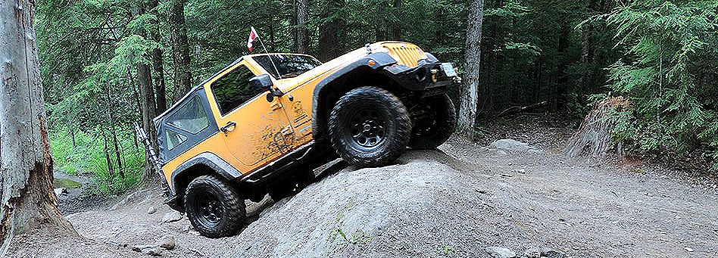
Checklist
WILDLIFE
Try not to disturb the wildlife. They’re not used to our rigs in their territory and will sometimes come to see what the noise is. Give all wildlife a wide berth, and if need be, stop and turn off your rig until the animal(s) leave the area. Don’t try to follow them - this is their turf and if they feel threatened, they can easily turn on you. Just enjoy the fact you actually saw something in it’s natural habitat.
SPEED
Slow down. Enjoy the scenery. Live the experience to the fullest. You don’t want to spend time repairing damage you wouldn’t have caused had you driven a little slower. Hitting standing water at speed is a sure way to drown under-hood electronics, not to mention it’s damaging to the environment.
PASSING
Just as on the street, you should stay right to avoid oncoming traffic, if you can. If common
sense tells you it’s safer to move left instead of right, then do so. If there is only room for one vehicle to pass, the rule is the more manoeuvrable vehicle, or the more experienced driver, should yield the right-of-way.
DUSTING
If you drive by someone on a dry dirt road at 15km or more, you are dusting them. Many 4x4’s are open-air, so a big cloud of dust is not just inconvenient, but hazardous if the driver’s eyesight or breathing is momentarily impaired. Always be considerate and mindful of what your actions cause.
BE CONSIDERATE OF OTHERS
Don’t block the trail. If you want to stop to watch others get through obstacles or take pictures, park well ahead and to the side if you are already through the obstacle so that there is room for others to stop as well and so that everyone can safely get through.
Don’t be a hot head. 4-wheeling is supposed to be a “family friendly” sport.
If you come across someone who is in trouble, offer some assistance. Signs of someone in
need of assistance include: someone walking along a 4x4 trail, a vehicle parked with the hood up, or someone looking under their vehicle, or waving at you as you approach. If you encounter someone on the trail who is stopped, it is cool to just say “Howdy”, or “Hi”. If you see a parked vehicle and no occupants, someone is on foot nearby, either intentionally or unintentionally, so be alert. Offer to call someone for them. If the vehicle requires towing, do so only if you are able, and both vehicles have proper recovery points.
TAILGATING
Always allow each vehicle to traverse the tougher obstacles one-at-a-time. Closely following
another vehicle is dangerous in any situation. In off-road driving, braking distances and manoeuvring is significantly affected. Keep distances of at least thirty feet between vehicles. This allows vehicles room to brake and maneuver, as well as sufficient distance to read the terrain and pick a line. On steep hills, downhill vehicles could be struck by debris flung from spinning tires, or worse, a rolling vehicle. All of us have experienced failed climbs. You do not want to be tailgating someone up a hill when he fails his climb.
BASIC TIPS
Always travel in groups of 2 or more vehicles
Always alert someone back home where you are going and when you expect to return
Take at least a basic supply of tools and gear (see The Basic, Minimal Off-road Checklist)
PRE-DEPARTURE MAINTENANCE CHECKLIST
• Check engine oil
• Check transmission oil
• Check brake fluid
• Check radiator coolant
• Check windshield wiper fluid
• Check fan belts
• Check hoses
• Check air cleaner
• Check seat belts
• Check tire air pressure (air up to recommended pressure for highway driving, air down at
trail head, air up prior to trip home)
• Check for tire wear or damage
• Tighten drive shaft u-bolts
• Check and tighten lug bolts
• Check for frame cracks
• Check brake pads & shoes (adequate braking pad material, in good condition and without
contamination)
• Check for loose bolts or nuts throughout vehicle
• Grease all fittings (u-joints, steering)
• Check gear oils: transfer case/differentials, replace if necessary
• Check Winch for proper operation, check winch cable for kinks, frays or damage, straighten winch cable if necessary
• Check shocks

Slide 8
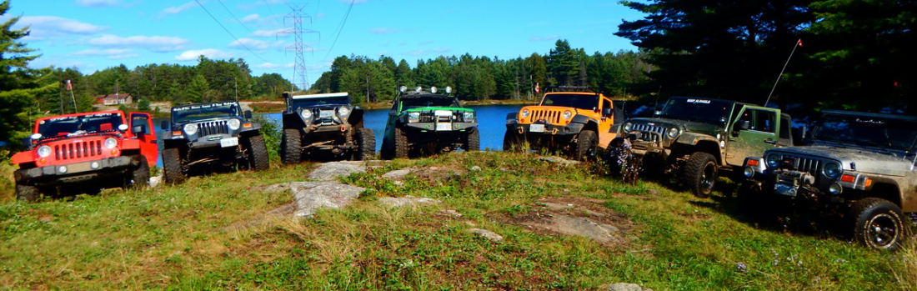
The Basics–MINIMAL OFFROAD CHECKLIST
BEYOND THE BASIC – Off-road Checklist
The minimal list is the basics that you should always carry in your vehicle when off-road. These items are good to have in the vehicle at all times.
• First Aid Kit • Basic Personal Essentials (water, food)
• Spare Tire, Full Size • Spare Key for vehicle
• Tow strap • Tree saver
• Come-alongs • Basic Tool Kit
• Jack and tire iron to change your tire
BASIC PERSONAL ESSENTIALS
Water
At least one Gallon per person, per day if not more. Drier, hotter climates may require more.
Food
Bring food for twice the amount of time you are planning on being gone. Should you be delayed and have to spend a night out on the trail, you wont have to worry about going hungry. Good ideas for trail food: trail mix, beef jerky, fruits, dry/canned food, etc.
Extra Cloths – Nobody likes to sit in wet cloths for an extended period of time.
Personal items – This includes toilet paper, anti-microbial hand cleaner, etc
• Sun block
• Rain Jacket
• Communication devices - Cell Phone, CB Radio, GMRS/FRS radios
• Power inverter if necessary (e.g. Cell phone charger)
• Trash bags - Keep your trails clean
• Maps, information about the area
• Compass or GPS
What goes beyond the basic checklist are items that depend on many factors. Factors like what form of off-roading you will be doing, your driving style, the terrain you will encounter, how much room you have for packing gear, how remote you will be traveling, how long you will be gone as well as many other factors you should consider. However three primary things you should gear up for are Safety and Survival, Vehicle Recovery and Vehicle Breakage.
VEHICLE RECOVERY
• Hi-lift Jack
• Tow straps - 2 or more, 2 inch width or wider, 20 foot or longer
• Tree saver
• Come-along (one or more)
• D-rings/Shackles
• Shovel
• Chainsaw and bar oil, 2 cycle engine oil, spare chain (can be handy in recover situations, as well as for trail clearing on wooded trails)
• Winch Kit: tree strap, hi-lift jack, snatch block, pickle fork, shackle, gloves
• Pull pal
• Snow tire chains (if tires don’t cut it)
BASIC TOOLS
Basic tools are the versatile, essential tool sets that consist of a variety of sizes and combinations of commonly used tools such as socket sets, wrench sets, Allen wrenches, Torx sets and screw drivers. Your tool sets should cover the variety of sizes found in your vehicle. Regardless of whether your vehicle is American made or an import 4x4, when it comes to socket sets and wrenches, it’s sometimes wise to carry standard and metric socket since sometimes there are a mix of both standard and metric on custom vehicles not to mention helping a fellow 4wheeler.
• Complete Socket Set with SAE (standard) and Metric with 3/8” and 1/2” drives.
Deep and standard sockets.
• Crescent, open end combination box wrenches SAE (standard) and Metric
• Allen Wrenches
• Torx sockets (especially if you own a Jeep)
• Standard & Phillips screwdrivers, large, medium, small
VERSATILE TOOLS – Versatile tools are those that have many uses.
• Large Hammer (a.k.a. the “BFH”) • Pliers (various sizes)
• Needle Nose Pliers • Vice Grips, various sizes
• Large channel-lock Pliers • Utility knife or razor blades
• Magnet • Crescent wrenches (medium & large)
• Pipe wrenches - having 2 medium of these can be useful for tie-rods.
• A BIG pry bar or length of strong metal pipe, inside diameter of pipe large enough to slip over a wrench or socket drive for extra leverage.

Slide 9
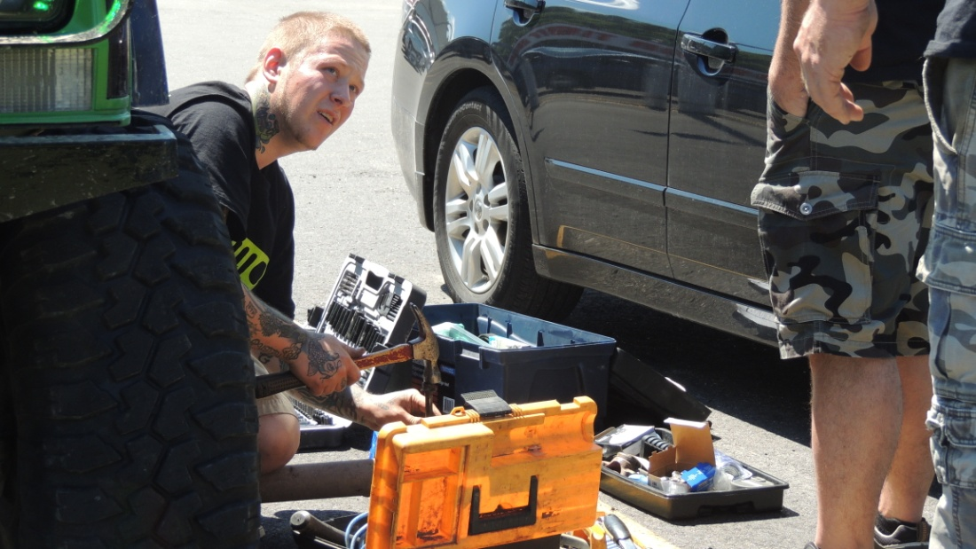
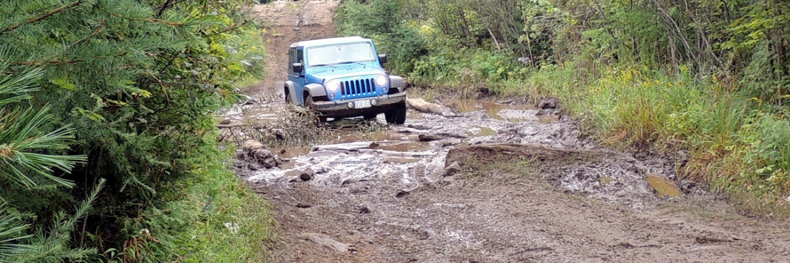
S
SPECIALTY TOOLS
• Snap ring pliers • Locking Hub Socket
• Air Pressure Gauge • Portable air pump
• Jumper cables
ADDITIONAL ITEMS
• Duct Tape • Bailing wire
• Ratchet Straps • Rope lengths
• Super glue • Epoxy
• Tie wraps • Rags
• Work Gloves, leather • Bungee cords
• Wood blocks - Useful as chock blocks, jacking platforms, ramps, suspension supports
(for broken torsion bars)
FOR THE VEHICLE
• Engine Oil • Brake Fluid
• Power steering fluid • Automatic transmission fluid
• Coolant or Water • Bearing Grease
• WD-40 • Starter Fluid
• Extra gas • Funnel, siphon hose
SPARE PARTS / REPAIR ITEMS
• Lug Wrench • Extra Fan / serpentine belts
• Hoses, fuel line, coolant hoses • Spare Tire
• Tire repair kits, plugs • Cotter pins / keys - various sizes
• Valve stems, Valve stem remover • Nuts & bolts assorted standard and metric sizes
• RTV or Hylomar HPF – form-a-gasket • Radiator stop leak – silver flakes in tube
• Spare Hub (and hub fuses if applicable). • Electric fuel pump
• Coil / electronic ignition • Spare Drive Shaft (rear and front)
• Extra spark plug wire • Spare parts
(size of longest wire)
• Spare Universal Joints (U-joints for drive shaft & axles)
• Extra Lug nuts, tire star wrench or lug key with key socket
ELECTRONICS REPAIR KIT
• Multimeter
• Wire cutters / wire crimpers / wire strippers (multi-tool)
• Spare fuses of all sizes and types used in your vehicle
• Electrical tape
• Spare wire – lengths of various gauges
• Spare switches
• Spare relay, if you use relays
• Crimp on terminals (male and female, various gauges and types)
• Small pocket sized needle point blow torch (handy for soldering wire)
• Flux core solder for repairs
• Wiring Diagram of your vehicle
EXPANDED LIST
The Expanded list includes items for the extreme wheeler with tools and gadgets that you may want to consider if you are serious about off-roading.
• Winch and Winch Accessories
• Onboard Welder, welding supplies and welding gear
• Onboard Air
• Spare axle shafts (rear left & right, front left & right)
• Spare tie rod assemblies (tie rod, drag link, ball joints, ball joint nuts and cotter pins)
• Spare Idler Arm
• Parts that have broken twice before (if you can’t carry it, you should have upgraded it)

Slide 10
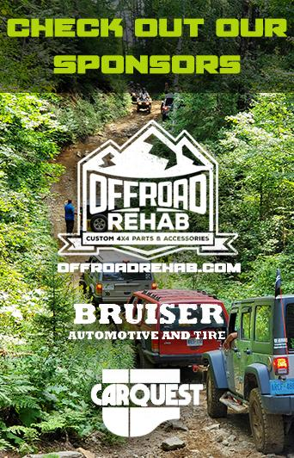
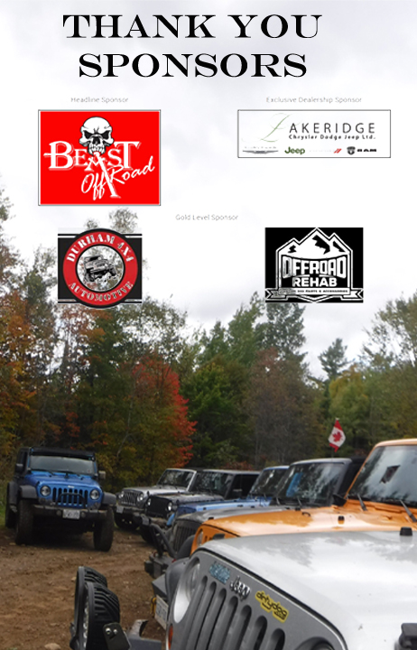
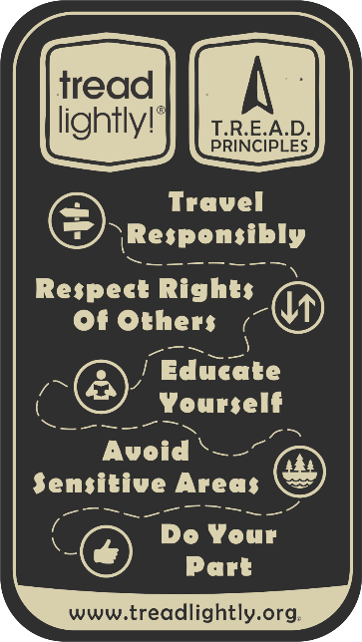

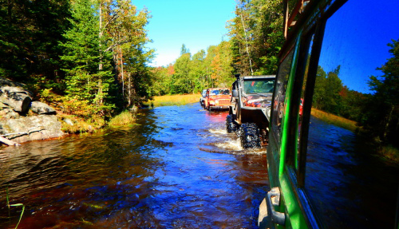
COORJC 4WD
Enthusiasts RESPECT Policy
Responsibility. You are responsible for your actions, vehicle, passengers, image, and impact on the environment.
Environmental respect, respect for other 4WD enthusiasts, respect for other user-groups, and respect for the trails.
Safety first! As a driver, passenger, and spectator always maintain a safe environment.
Prepare for any situations that you may encounter while
4wheeling, both likely and unlikely.
Educate yourself and others as to appropriate use of 4WD vehicles and the rules & regulations of the region you intend to 4-wheel in.
Clean-up after yourself and others. Try to leave the land cleaner than when you arrived.
Togetherness & teamwork, offer your help to those you meet on the trail, and never go 4-wheeling alone.

